Slide 1
Collection

Slide 2
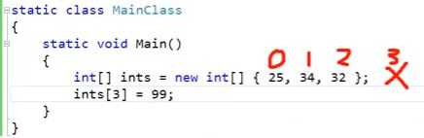
Why list?

Slide 3

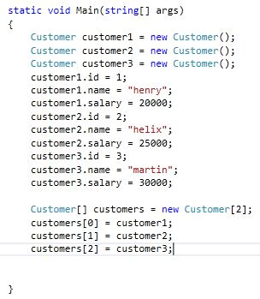
Why list?

Slide 4
List
Two types:
1. non-generic e.g. ArrayList
2. Generic e.g. List<T>

Slide 5
ArrayList
ArrayList is a non-generic type of collection in C#. It can contain elements of any data types. It is similar to an array, except that it grows automatically as you add items in it. Unlike an array, you don't need to specify the size of ArrayList.
ArrayList myArryList = new ArrayList();
arryList1.Add(1);
arryList1.Add("Two");
arryList1.Add(3);
arryList1.Add(4.5);

Slide 6
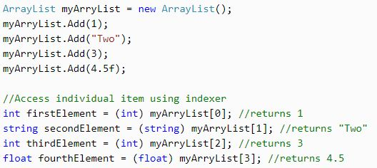
Problem of ArrayList

Slide 7
List<T>
The List<T> collection is the same as an ArrayList except that List<T> is a generic collection whereas ArrayList is a non-generic collection.
List<int> numbers = new List<int>();
numbers.Add(1);
numbers.Add(2);
numbers.Add(3);

Slide 8
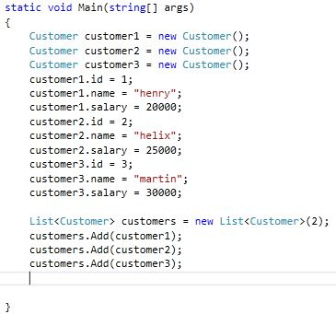
If list limit exceed??

Slide 9
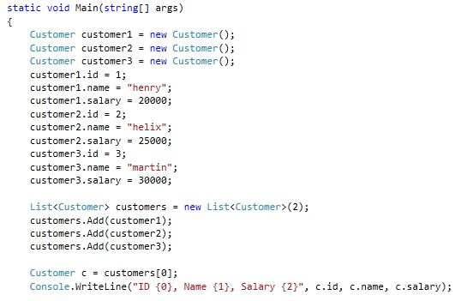
Accessing list elements

Slide 10
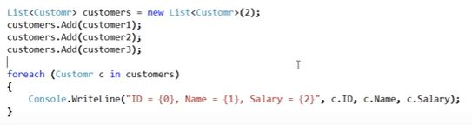
Foreach loop

Slide 11
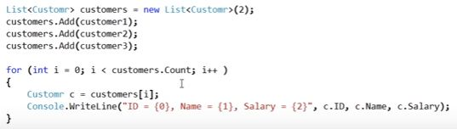
For loop

Slide 12
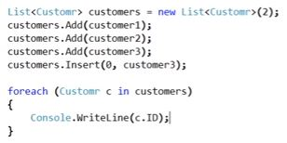
Inset an object at a specific index

Slide 13
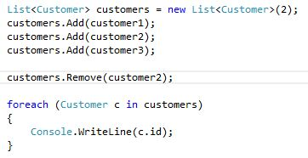
Remove list element

Slide 14
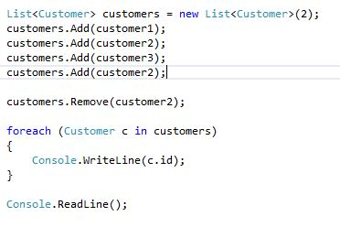
What if same element at different index?

Slide 15
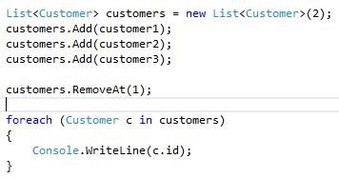
Remove list element using index number.

